Slide 1

Know It Owl
Anupriya
Divya
Aswathi
Sourab
May 2019

Slide 2
Problem Statement
Considerable amount of time wasted in going through large data, documents, books or articles for answers that could be inaccurate, in various sectors ranging from medicine to research to law.
Solution
Chatbot which provides accurate answers to end user questions related to large data saving considerable amount of their research time.

Slide 3

Demo Link – portal.azure.link

Slide 4
Scenarios

Slide 5

Petronas

Slide 6





Petronas Employee
Natural Language Query / Answer to query
Knowledge Base Unstructured Data

Slide 7

Teams Bot

Slide 8


End User
Natural Language Query
/ Answer to query
Teams Files
SOW
Functional Requirements
Work Order/Contract

Slide 9
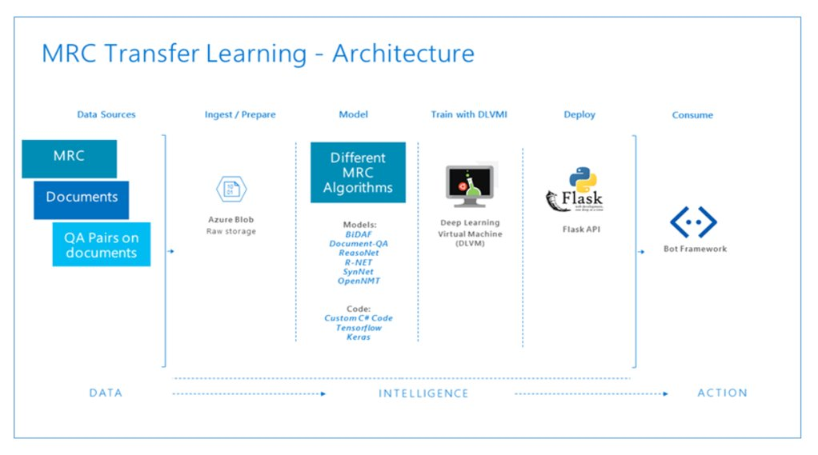
BERT
R-Net

Slide 10
Market Research

Slide 11
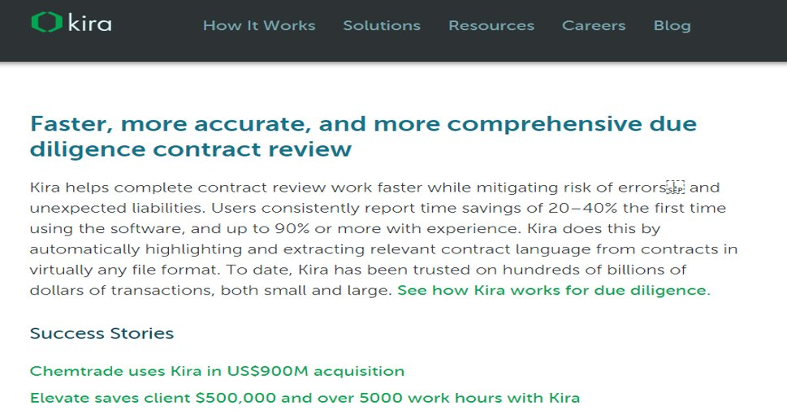

Slide 12
Prototyping Data

Slide 13
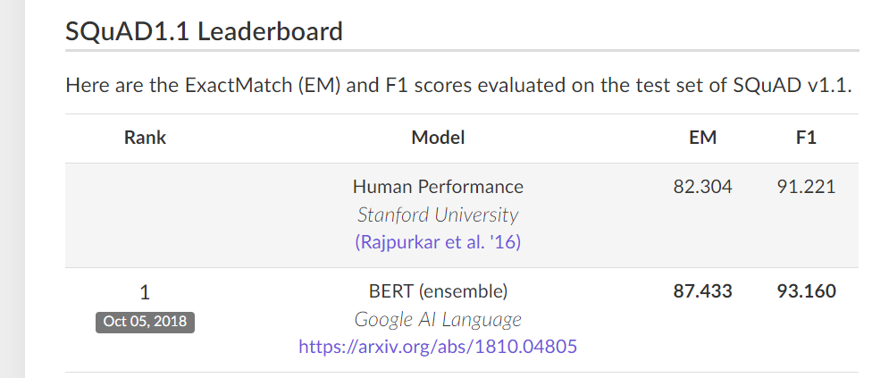
Qualitative
Supports natural queries and unstructured natural data. User doesn’t need to learn complex search syntaxes, regex etc. Simplifies the research spent in finding answers by abstracting away technical complexities.
Achieves human level performance in terms of providing accurate answers to the natural language queries based on comprehensions.

Slide 14
Quantitative:
Companies on similar lines like Kira, ROSS etc. have shown clients save around 30-60% research time.
Data and key insights from your prototyping sessions
Model was able to understand semantic relationships and concepts between words, could derive context and provide accurate answers.
Learnt that there are subtle other real-life scenarios like spell check, support for different document types like pdf, word documents etc.
There were certain limitations like upper bound on answer length, model providing answer even when query and comprehension were unrelated etc.

Slide 15
The Ask
3 weeks to make it production ready.
Docker for containerization
TensorFlow Serving for a model hosting
Kubernetes for production deployment

Slide 16
Future and scope
Serving in Production: Currently, for every request TensorFlow is creating the graph to serve the request. In production environment, we will be using TensorFlow production, protocol buffer (protobuf) format of model and host our model in Kubernetes Docker. This will avoid creating graph to serve every request and is highly scalable capable of serving a high volume of requests. This also increases maintainability of the model.
Using cognitive services like machine translation to support multilingual articles and queries.
Integration with Microsoft teams.

Slide 17
Discussion & Feedback

Slide 18


